Slide 1


Course Name: Biomedical Modelling & Simulation Sessional
Course No: BME 310 (Level-3 Term-1)
Group: 02
Submitted By:
1. Md. Ebrahim(1911006)
2. Asma Sadia(1911007)
3. Ummul Kainatt(1911008)
4. Moontasir Bin Salim(1911009)
5. Pritam Banik(1911010)
Human Gait Analysis Using MATLAB
Supervised By:
Dr. Sumit Majumder
Asst. Professor,
Dept. of Biomedical Engineering, CUET

Slide 2
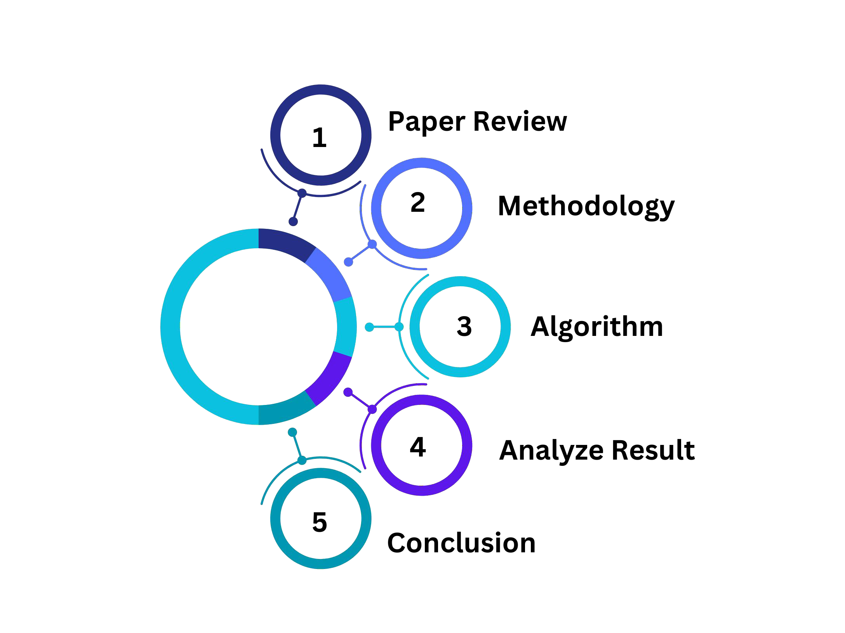

CONTENTS

Slide 3
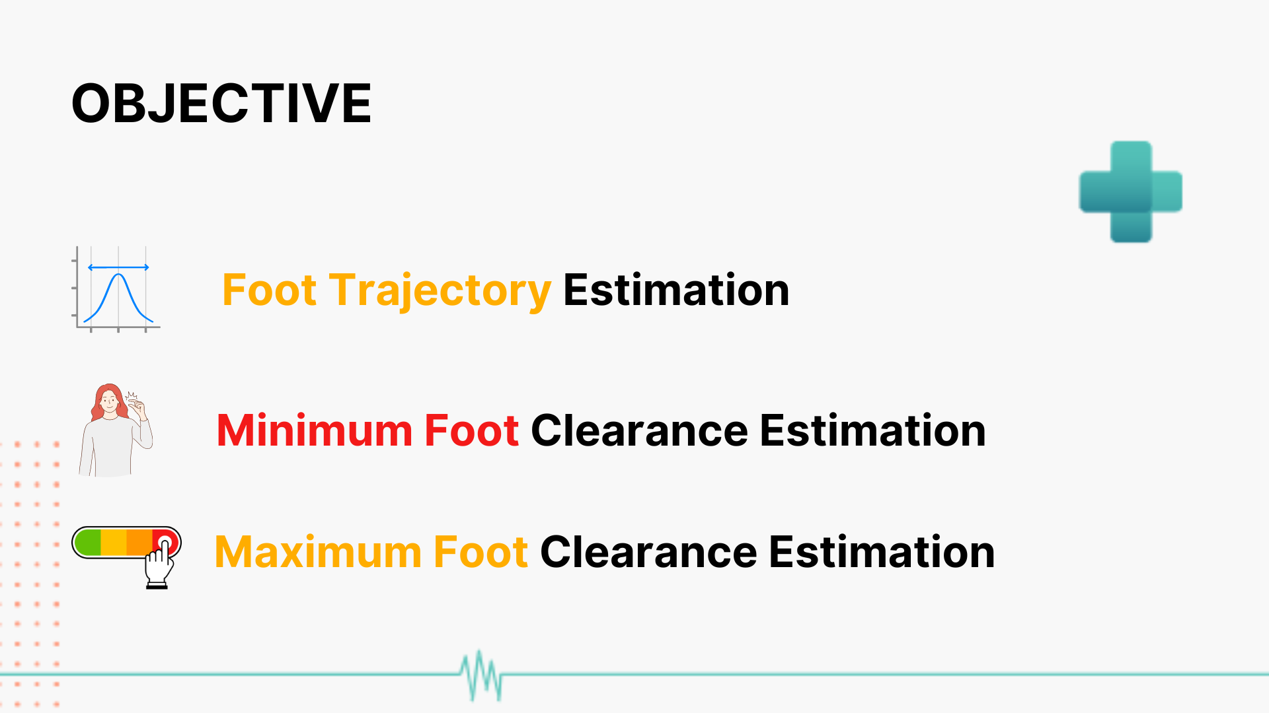

Slide 4
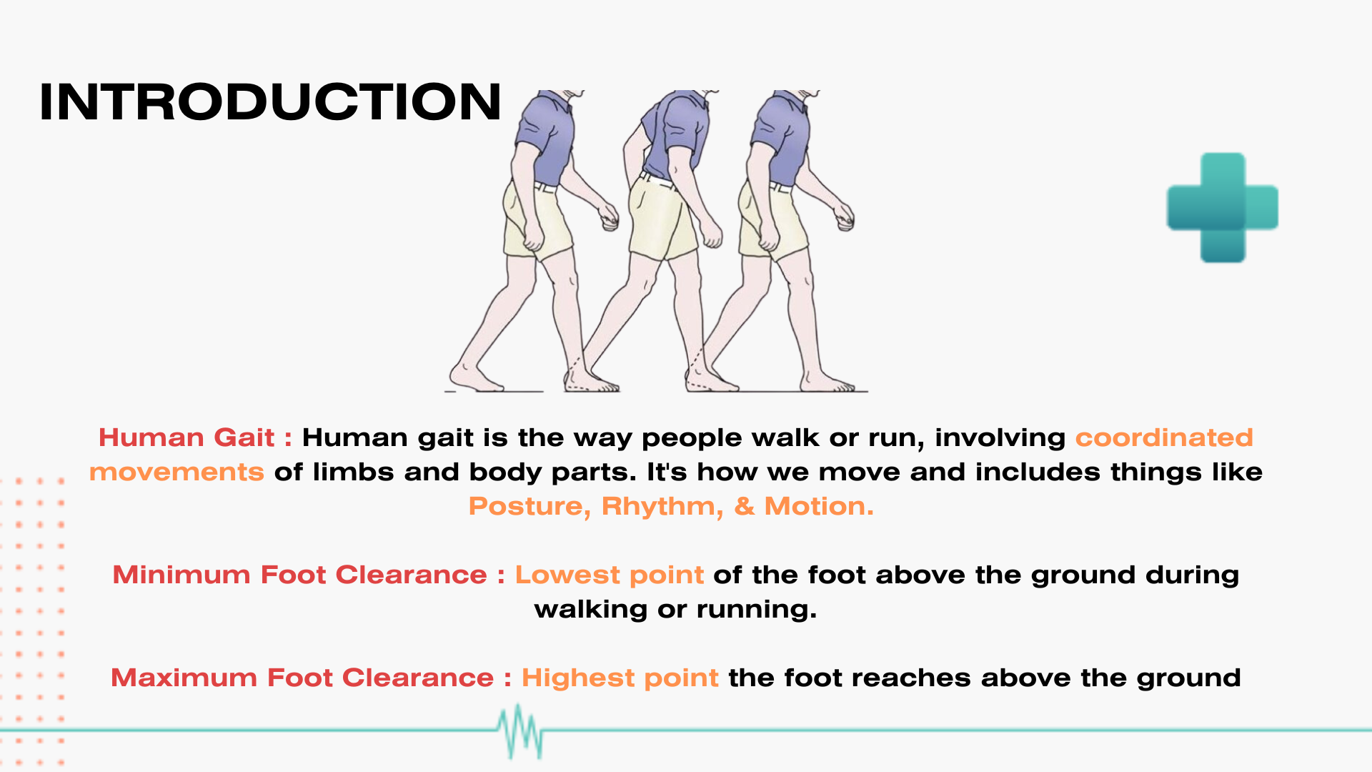
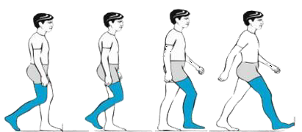


INTRODUCTION
Human Gait : Human gait is the way people walk or run, involving coordinated movements of limbs and body parts. It's how we move and includes things like Posture, Rhythm, & Motion. Gait analysis studies this movement for health and biomechanical insights
Minimum foot clearance : Lowest point of the foot above the ground during walking or running.
Minimum foot clearance : Highest point the foot reaches above the ground.

Slide 5

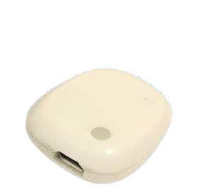
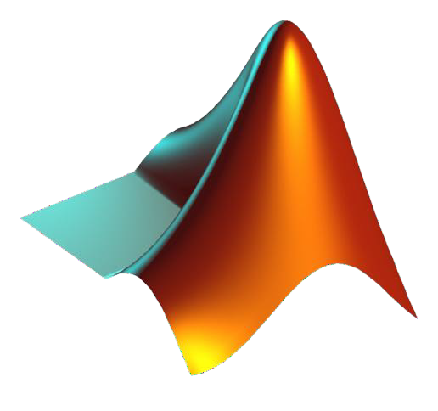
REQUIRED EQUIPMENTS
Meta wear Sensor
MATLAB Software
Tri-Axial Accelerometer & Gyroscope
Bluetooth-Compatible
programming platform
Analyze and Design Systems

Slide 6
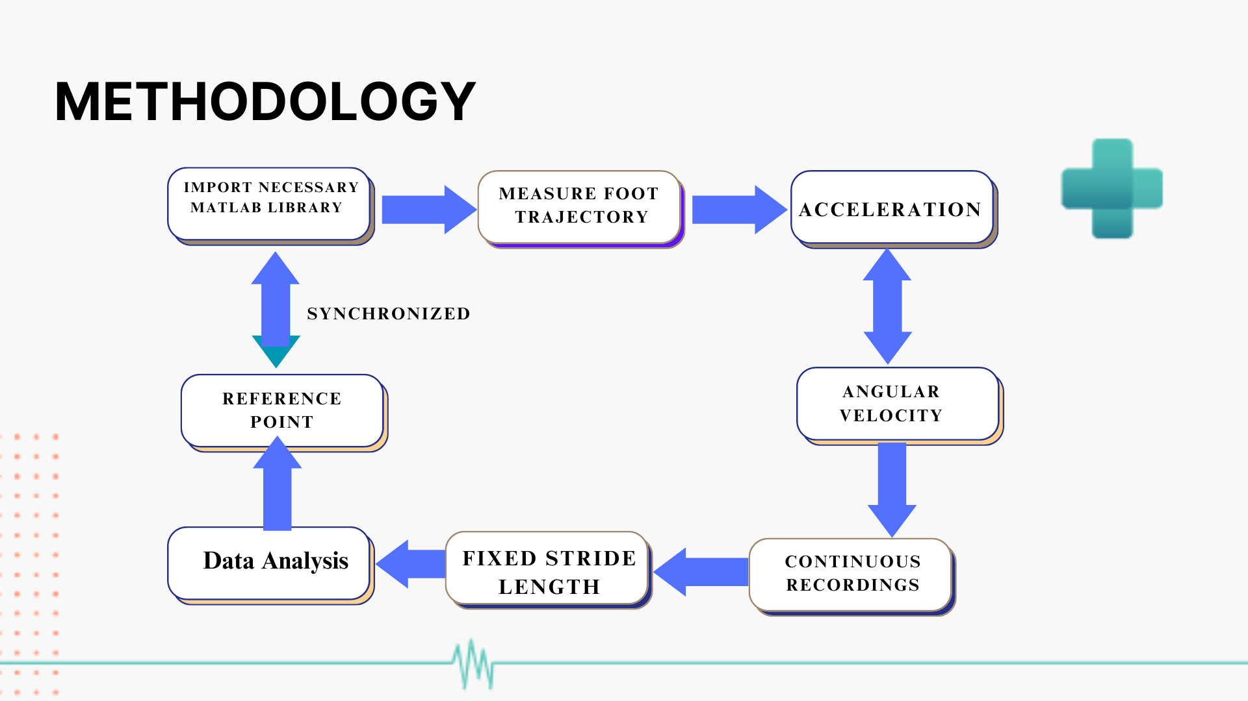

Slide 7
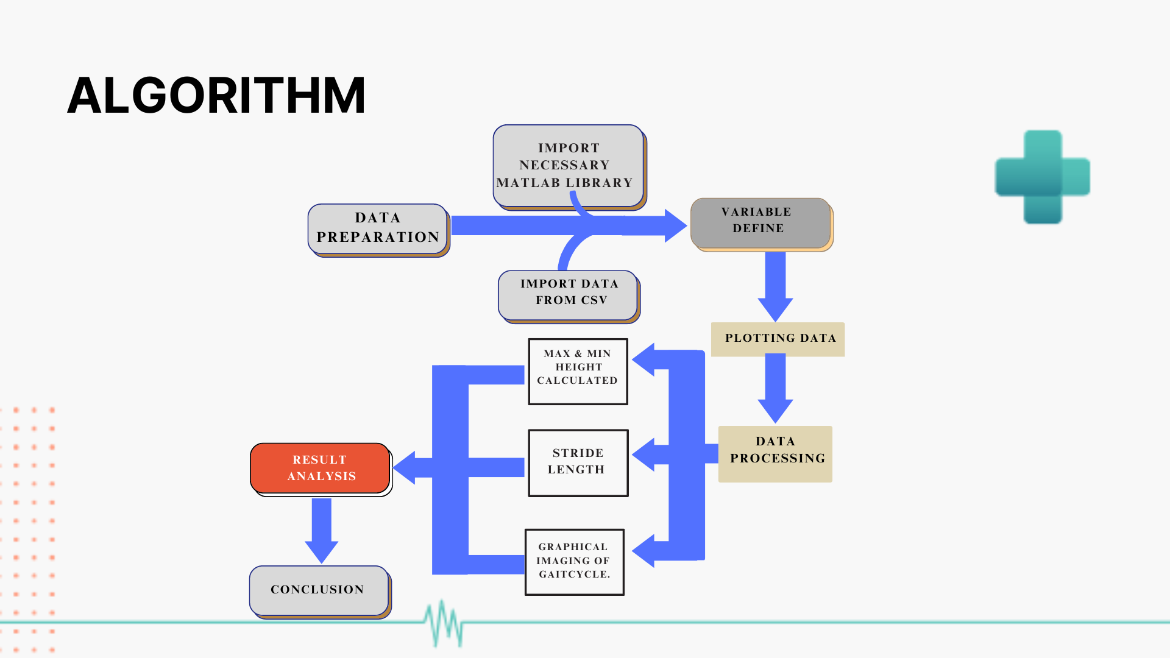
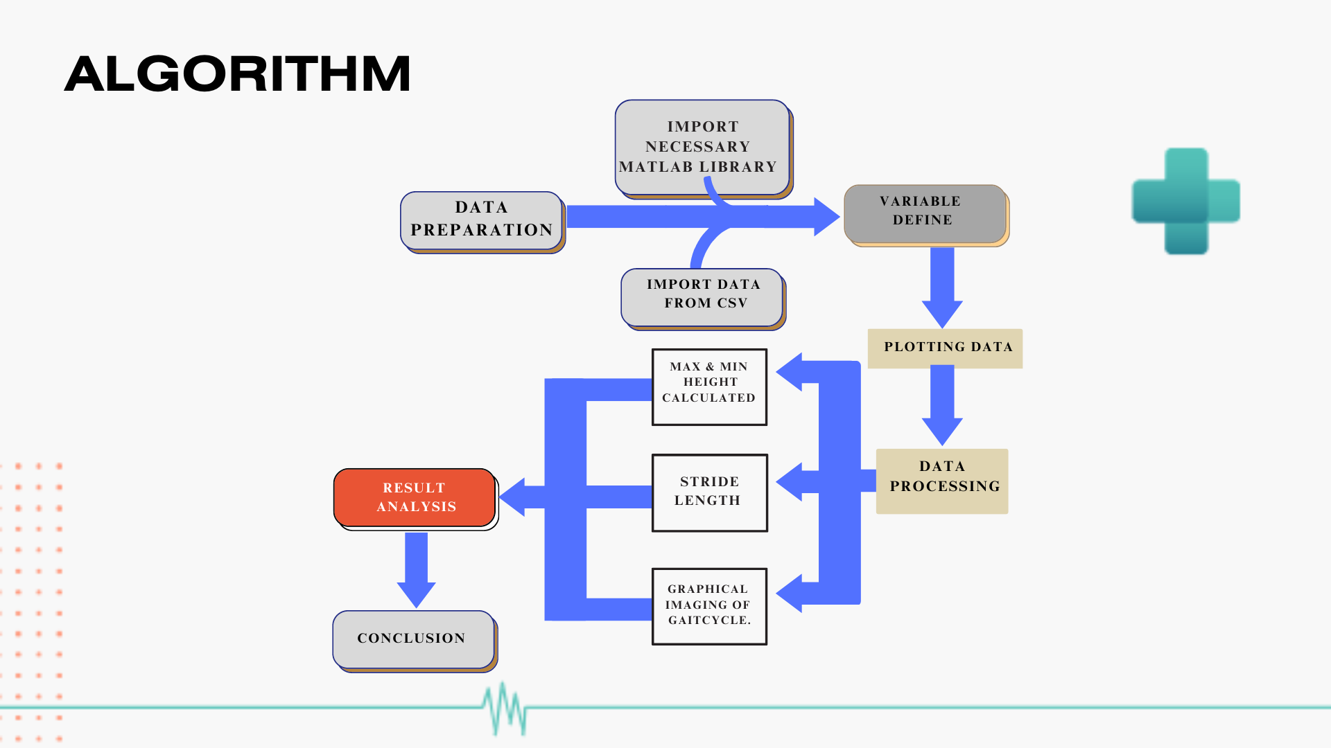
Algorithm

Slide 8
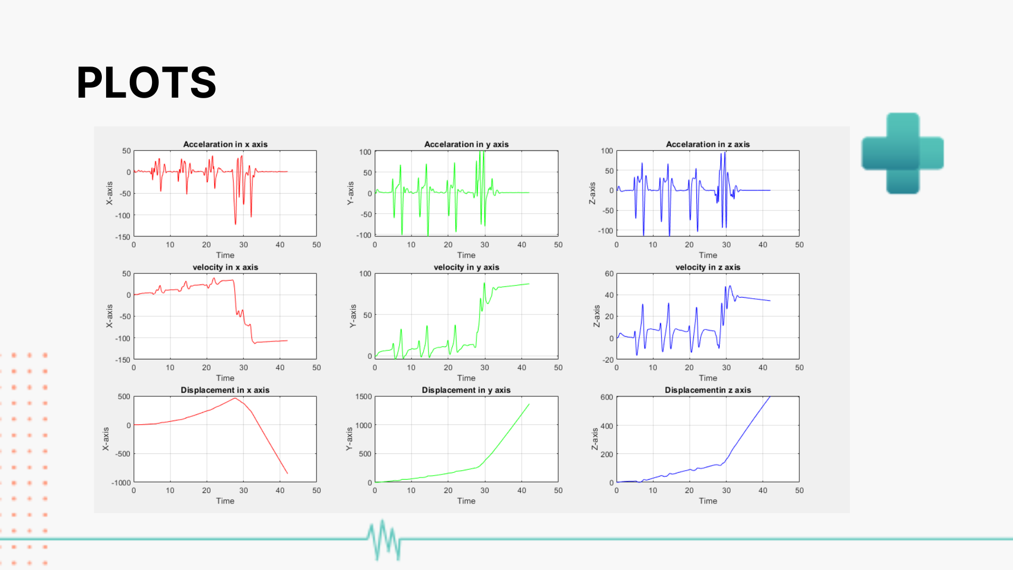
PLOTS

Slide 9
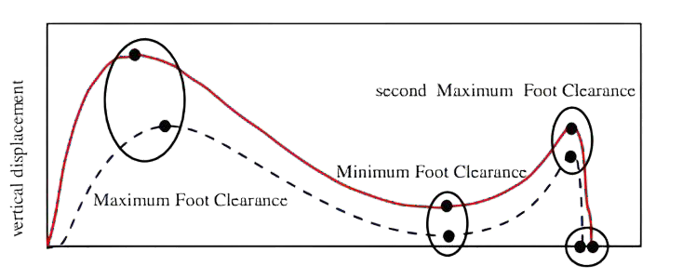
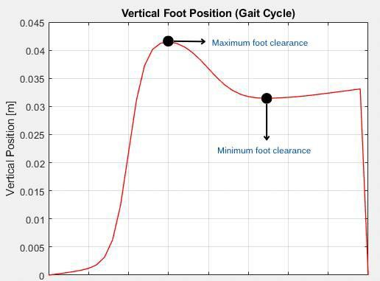


Result Comparison
Desired Plot & Data
Experimental Plot & Data

Slide 10
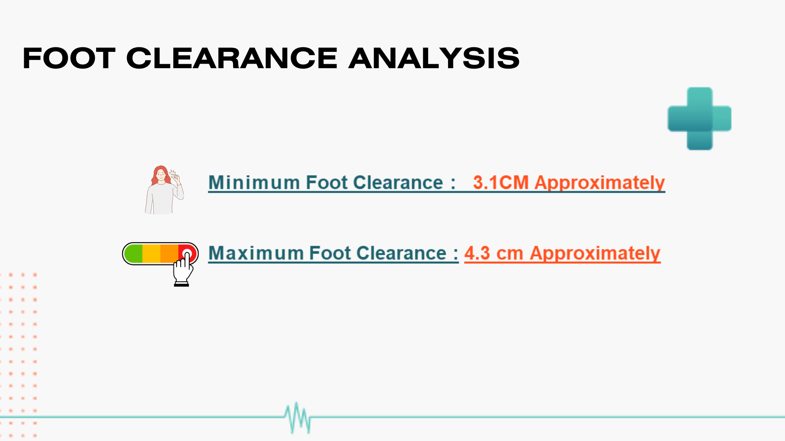

Foot Clearance Analysis
Minimum Foot Clearance : 3.1CM Approximately
Maximum Foot Clearance : 4.3 cm Approximately

Slide 11
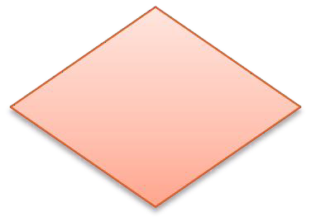
EXPERIMENTAL FLOWCHART
No
Is experiment al data is similar to theoretical data?
Data Acquisition
YES
Analyze Output Data
Start
Programming
End

Slide 12
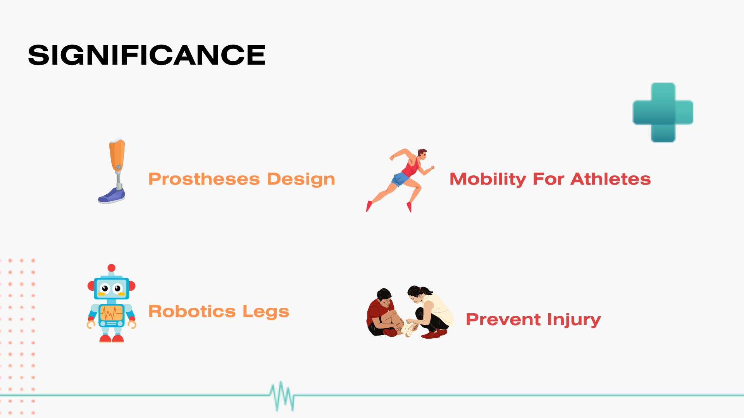

SIGNIFICANCE
Prostheses Design
Efficient Mobility for Athletes
Robotic Legs

Slide 13
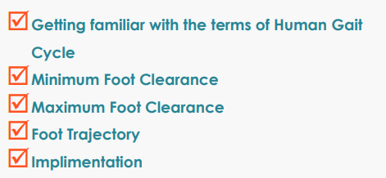
CONCLUSION

Slide 14




Thank You

Slide 15
Do You Have Any Questions?

